Slide 1
Creating a Jukebox using Java

Slide 2
Introduction
A Jukebox is a mechanical or digital device that plays music selected by users.
Traditionally, Jukeboxes were found in public places like bars or diners, allowing people to select and enjoy their favorite tunes.
In the digital age, Jukeboxes have evolved into software applications that can be run on various devices, including computers and smartphones.

Slide 3
Key Features of Jukebox
Music library management: Organizing and storing a collection of songs.
Song selection: Allowing users to choose their favorite songs from the library.
Playback control: Offering functionalities like play, pause, skip, and volume control.
User-friendly interface: Designing an intuitive and visually appealing interface for a seamless user experience.

Slide 4

Technology Used
Key technologies used here are:
IntelliJ IDE Community Edition
MySQL workbench

Slide 5
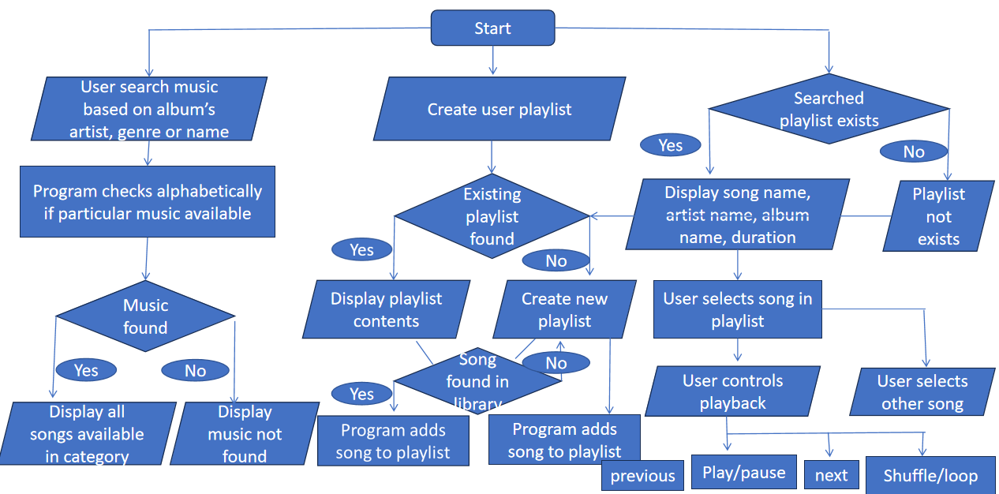
Flow Diagram

Slide 6
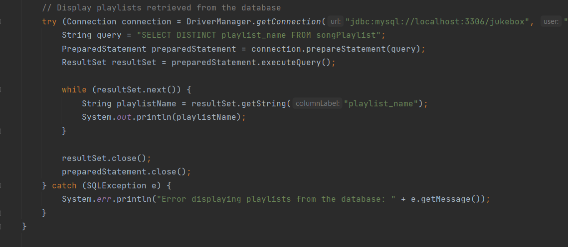

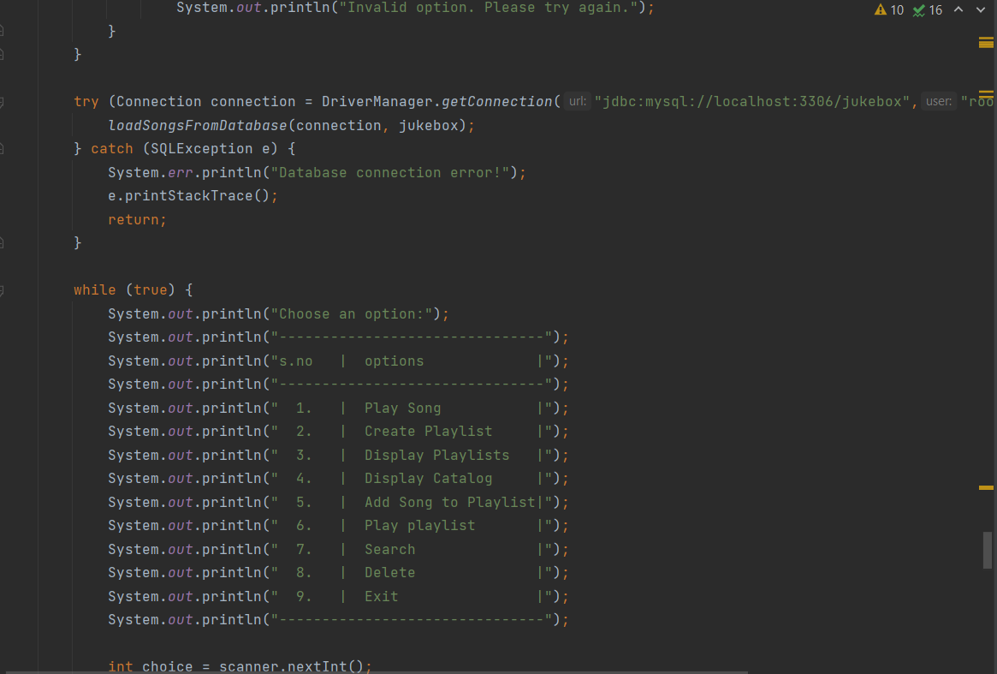
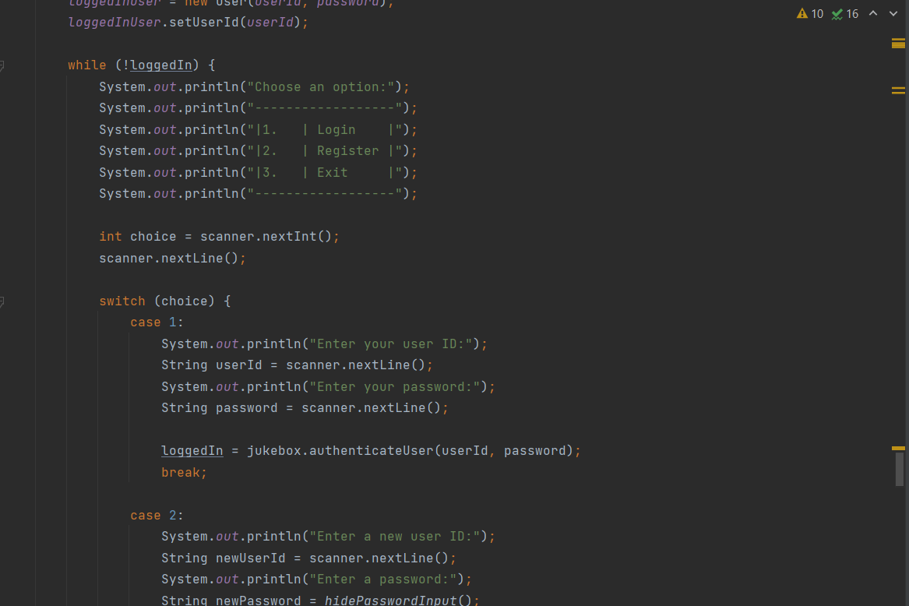
Snapshots

Slide 7
Future Scope
As we look ahead, there are several exciting avenues for future development and enhancements for our Jukebox application. Some of these include:
Integration with online music services: Explore opportunities to integrate the Jukebox with popular streaming platforms, allowing users to access a vast library of songs.
Customization options: Allow users to customize the Jukebox interface, such as themes, wallpapers, or personalized playlists.
Social sharing features: Enable users to share their favorite songs or playlists on social media platforms, fostering a sense of community and musical discovery.
Smart recommendations: Implement algorithms to suggest songs based on user preferences and listening history, providing a more personalized music experience.
Mobile application development: Extend the Jukebox to mobile platforms, enabling users to enjoy their favorite music on the go.

Slide 8

Questions

Slide 9
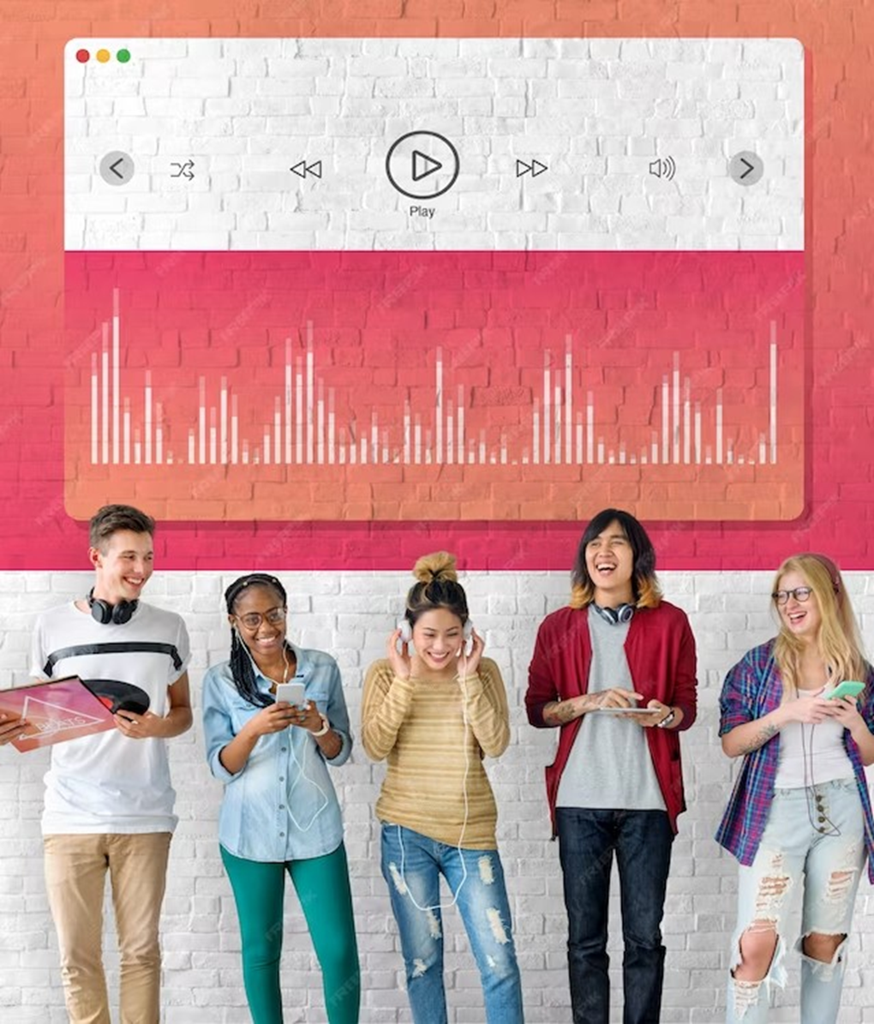
Thank You

